Slide 1
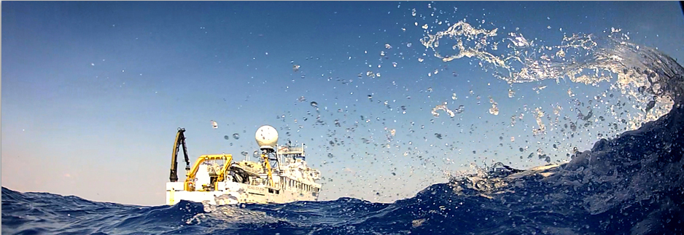

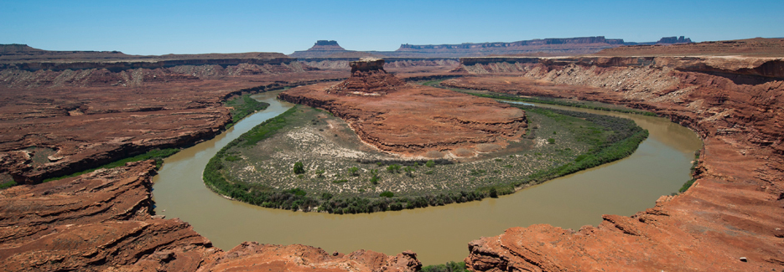

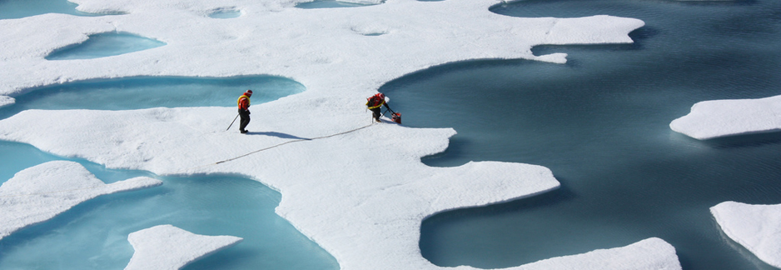

EarthCube
Past, Present, and Future
Excerpt from “EarthCube: Past, Present, and Future.” Yolanda Gil, Marjorie Chan, Basil Gomez and Bruce Caron (Eds). EarthCube Project Report EC-2014-3, December 2014. Available online at:
http://earthcube.org/document/2014/earthcube-past-present-future.
EarthCube is an initiative of the National Science Foundation. Any opinions, findings, and conclusions or recommendations expressed in this material are those of the author(s) and do not necessarily reflect the views of the National Science Foundation.

Slide 2
EarthCube
Past, Present, and Future

Slide 3
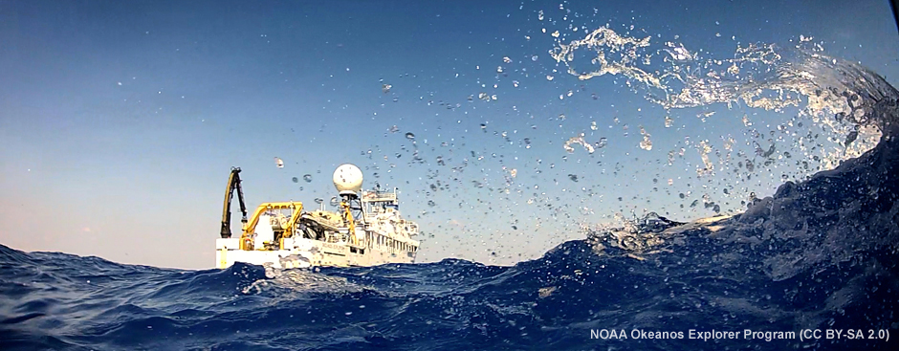
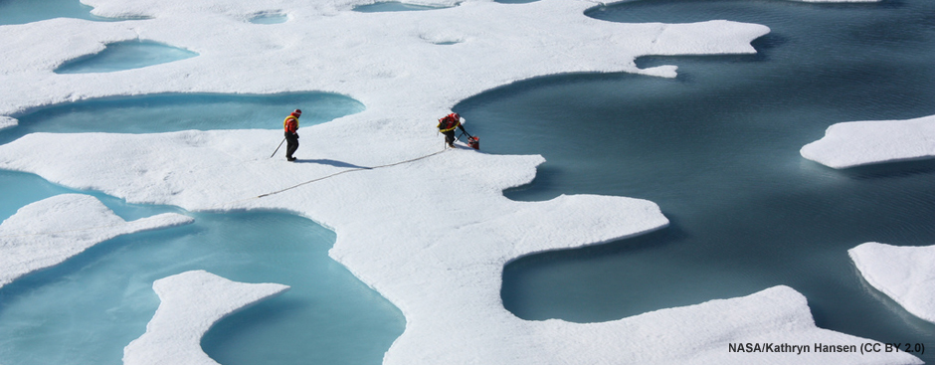
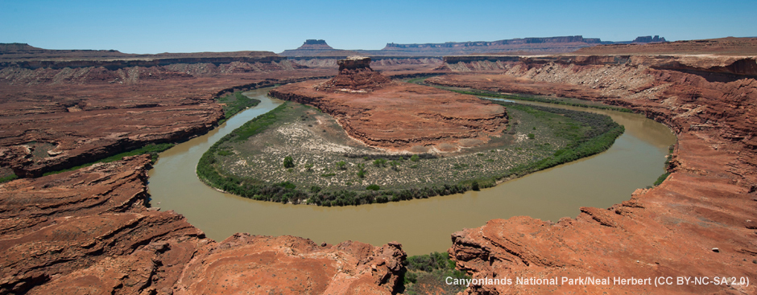
Front page images with credits

Slide 4
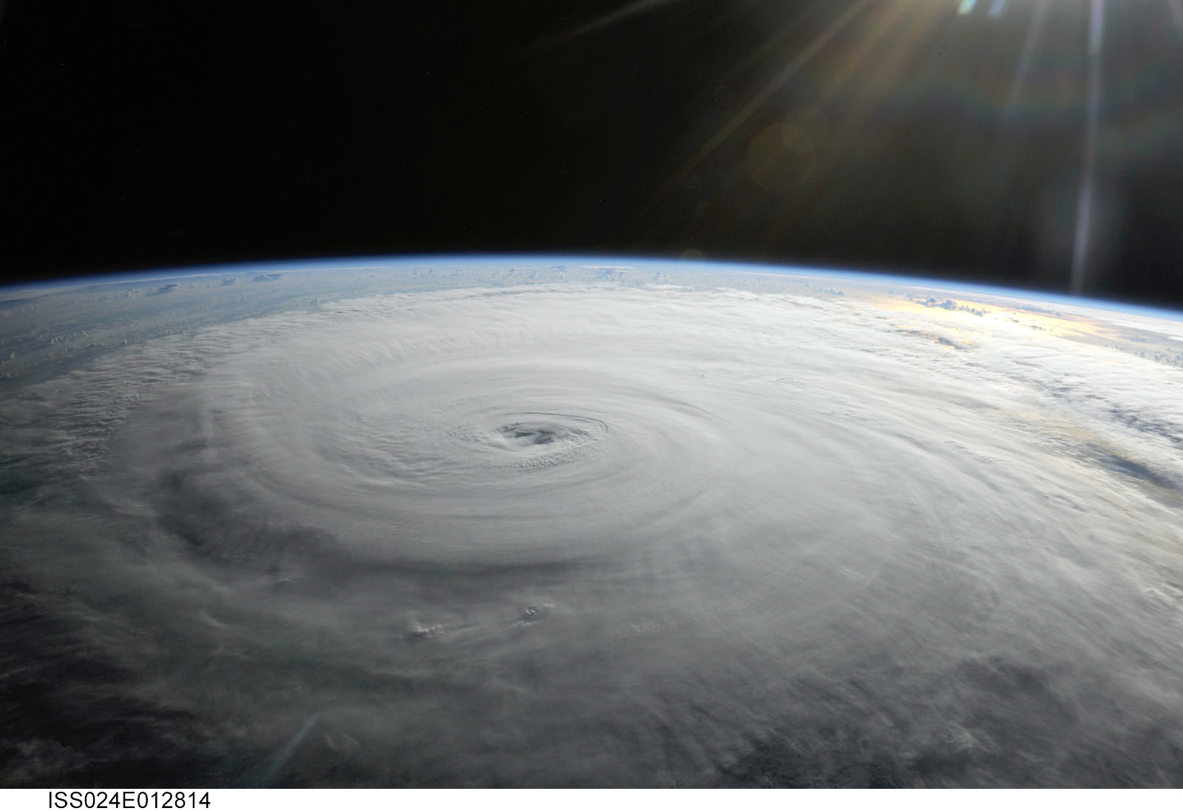
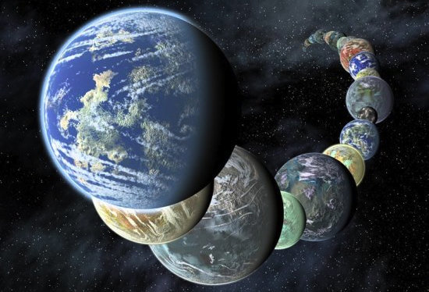

EarthCube.org

Slide 6
EarthCube.org

Slide 7
https://creativecommons.org/licenses/by-nc/2.0/
https://www.flickr.com/photos/nasamarshall/4994478045/in/photolist-6aNxfo-6Hkich-7mXbeQ-6PyKqc-bAc1Qv-7hNfWX-7b8Yb2-9eygaX-8LuCdh-bBh4BV-bAc8e1-8pSW3J-8Bm1jr-9kK8PL-9sYDeM-hMtw4i-nrH5Cc-8uHAxD-6QLR4D-dkvvGV-8x1cP7-9dhUXT-7jHTYB-4kxiKt-dAP2Qf-6xxerB-ddNRt4-kjkJ5N-bJTznr-9Vtbdt-8XfPZW-bJzsN8-7JkuD7-bEmC1t-6Vu1zB-bYy4DQ-6UaHyi-73Nyyw-7DMcUa-9n5gg1-954op6-7zbMrc-khYnQC-bo4u3A-7CfoiH-jC5dx3-72mZFJ-aZsyzH-7ApSVi-5X4oqb

Slide 8
https://creativecommons.org/licenses/by-nc-nd/2.0/
https://www.flickr.com/photos/nasamarshall/4038941623/in/photolist-79UCCx-nx5tts-9gZpgw-6GmvLD-a7Aykh-8cgG6f-fue4yp-7xnrUv-9cRJNU-6JLH7w-aDCFzC-nuM4RK-6MmWBB-55zSBY-9ifm1Y-6cThFv-741VDU-91MAZ9-bq7L6J-ahLJ9C-bbibXF-7vp7d1-bRYwBH-6Umfkt-6Xsffx-77UjxD-ac6esS-5BJH5e-bGoWnD-oWv5Tp-8e1Pdt-9p2dYy-6Et9QZ-6TB3Lh-kwsqSg-fjkn3j-7WZ5ua-azGKRB-8zRDxu-hnfxX1-otK2eW-8JH9Qx-ax4Z2k-9aTExb-8xe1uc-9D8mTV-9pzSDn-nBwAyW-bpnxFD-czvDGG

